Slide 1
CS 498
Virtual Reality
4/8/2019

Slide 2
Production (in this case video games): Where this class fits in
Month 1 | Month 2 | Month 3 | Month 4 | Month 5 | Month 6 | Month 7 | Month 8 | Month 9 | Month 10 | Month 11 | Month 12 | Month 13 | Month 14 | Month 15 | Month 16 | Month 17 | Month 18 | Month 19 | Month 20 | Month 21 | Month 22 | Month 23 | Month 24
POC Work (~6-9 Months)
 |  |  |  |  |  | Production (~14-16 Months)
 |  |  |  |  |  |  |  |  |  |  |  |  |  |  |  |  |  |  |  |  | Lock Down
 |  |  |  |  |  |  |  |  |  |  |  |  |  |  |  |  |  |  |  |  | Sub/Man/Distrib
 |  |  |  |  |  |  |  |  |  |  |  |  |  |  |  |  |  |  |  |  |  |  | Street
Proof Of Concept
Production
Alpha
(Feature Complete)
Beta
(Content Complete)
Discovery (already done) |  | Discovery (2 week Milestone) |  | Pre Production (3 Week Milestone)
 |  |  |  |  |  | Production (9 Weeks)
 |  |  |  |  |  |  |  |  |  |  |  |  |  |  |  |  |  |  |  |  |  | Street
Proof Of Concept
Discovery & Pre-Production:
Production (3-5 weeks)
Alpha

Slide 3
Design Docs Process
Start
S01
Home Base
S02
Mission
S03
Combat
S04
Exploration (F02)
Progression (F01)
Encounter
System
Upgrades
S02a
Nav system
Ranged
Result System
Melee
Customization
S02b
Loss System
Win System
Combat (F03)
Mid-Level Action Loop (example)
References Features
Breaks down higher level areas
Reward
System

Slide 4
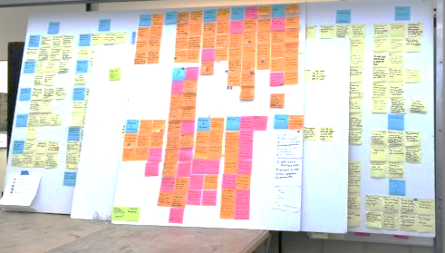
Task Development: Feature Board
http://www.edudemic.com

Slide 5
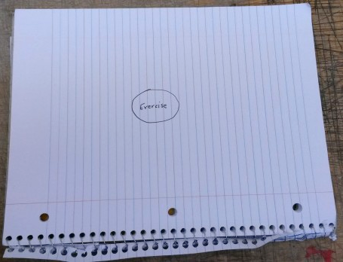
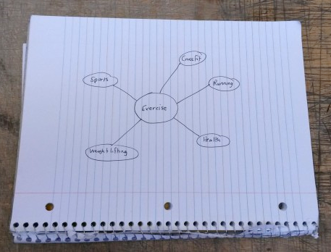
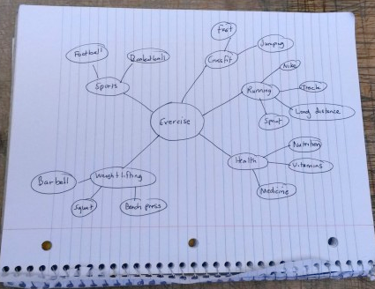
Task Development Mind Mapping (mapping out your ideas with details)
Feature
Support
(Programming, Art, UI, Design, etc.)
Feature
Support
Details/Considerations
http://www.edudemic.com

Slide 6
At this point….
Milestone Process: review the schedule:
What has changed because of the current milestone?
Do we need to change the scope?
Are there any new features or uncovered tasks that were not planned?
If yes, what is the impact on the schedule?
Are there any dependencies that weren’t expected?
Do programmers need assets?
Do asset creators need information about how things should be made?
Should we test out our experiences?
Is there a test plan segment for those areas we need to test?
How do we need to plan the next milestone?
What changes need to be made?
Do we need to shift resources?
Don’t forget the revisions to the test plan.

Slide 7
Production Tools/Methods for the team
An Overview of the professional tools/methods we used at Volition to drive the team
Project Management Systems
Waterfall
Agile/Scrum
Feature Driven Development
Project management Software
Planning Poker
Hansoft
Jira
Asset Database
SWOT Testing (Strength, Weakness, Opportunities, Threats)
Voice/Narrative database
QA Database
Build System
Version control
Automated Testing
Outsourcing
Meetings or lack thereof

Slide 8
VR Design Examples/critique and discussion
Arktika.1 VR
https://www.youtube.com/watch?v=A3FCssd-SK0
Batman Arkham VR
https://www.youtube.com/watch?v=g0zBx1KiUU0
Rick and Morty VR, Virtual Rick-Ality
https://www.youtube.com/watch?v=P5lAtNFbH_0
Theseus VR
https://www.youtube.com/watch?v=DN7EpzL4Y5g

Slide 9
Processes that can help your design (detail development NOT brainstorming)
Design Revisions
Feature Board
Project Management method (used in milestones and feature management)
Color Coded Sticky pads
Can be by Discipline
Can be by Feature
Contains Requirements for programming, art & design
Mind Mapping
Project Plan

Slide 10
VR Design Examples/critique and discussion
Arktika.1 VR
https://www.youtube.com/watch?v=A3FCssd-SK0
Batman Arkham VR
https://www.youtube.com/watch?v=g0zBx1KiUU0
Rick and Morty VR, Virtual Rick-Ality
https://www.youtube.com/watch?v=P5lAtNFbH_0
Theseus VR
https://www.youtube.com/watch?v=DN7EpzL4Y5g

Slide 11
VR Design Examples/critique and discussion
Marvel United VR
https://www.youtube.com/watch?v=94L6KHOQG0M
https://www.youtube.com/watch?v=7Ystx0up86U
https://www.youtube.com/watch?v=LCwZ1gOp5ag
Fallout 4 VR
https://www.youtube.com/watch?v=S0D0N2SYHlI
Beat Saber VR
https://www.youtube.com/watch?v=2KCo3zjAaOM

